Slide 1
CPE 221: Computer Organization
03 Instruction Set Architecture and ARM Basics
rahul.bhadani@uah.edu

Slide 2
Announcement
HW02: Due Jan 24, 2025, 11:59 pm.

Slide 3


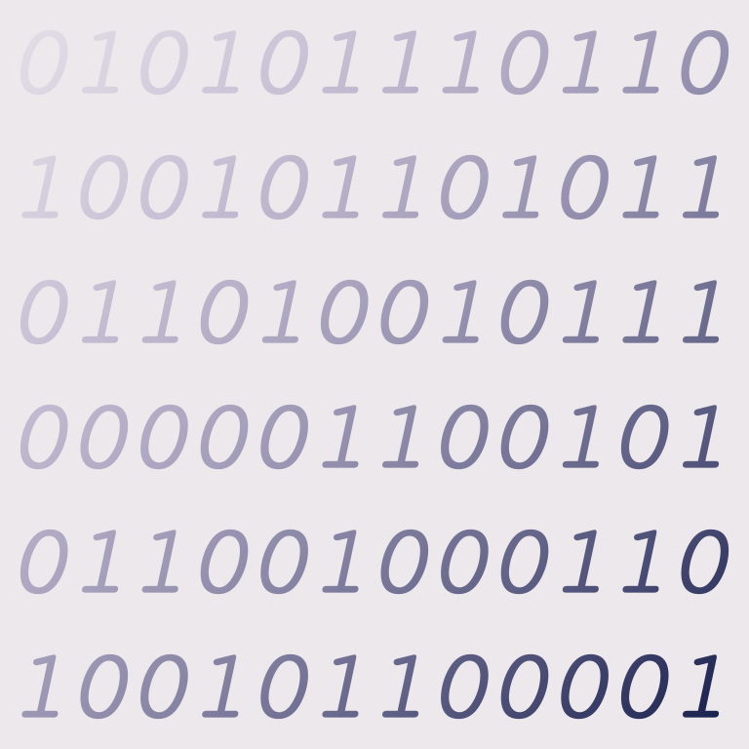
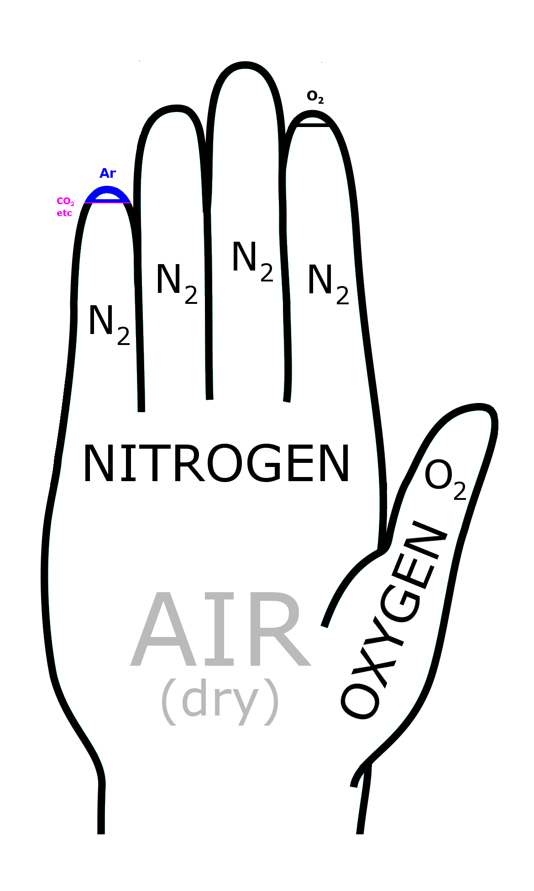
Architecture
Programmer’s view of a computer
Instruction -> the language that computer understands
Instruction set -> vocabulary of the computer
Binary is used to encode instructions, same way words in English language is encoded in Alphabets.
For us, humans to understand instructions, we code them using mnemonics called Assembly language.

Slide 4

Instruction Sets
We can have many instruction sets just like there are many languages.
E.g. ARM, x86, MIPS, SPARC, RISC V, etc.

Slide 5
Hardware ≠ Architecture
E.g. Intel and AMD both have x86 pc but different hardware specifications.

Slide 6










ARM Architecture
ARM designs computer architecture but doesn’t build one.
It sells licenses to other companies to build.
Advanced RISC Machines Ltd, formerly known as
Acorn RISC Machine

Slide 7
Stored Program Machine

Slide 8

Stored Program Architecture
ARM:
Operates in fetch-execute mode where :
Instructions are read from the memory
Decoded
Executed
Memory
Program + Data

Slide 9
Fundamental Structure of a Computer
Most basic Computer = Register + ALU + Buses
CPU
Register
R1
Register
R2
Register
R4
Register
R3
Memory much larger
Address : 32 bit or 64 bit
Register
R3
15-32 registers

Slide 10

Assembly Language and Instructions
Human-readable version of the native language of computers.
Instructions are common operations that a computer is supposed to do.
ADD a, b, c
0x BD EF …
Assembler

Slide 11
Instructions in Memory and Special Registers
Each instruction (like ADD 3 + 4) is stored as a binary string in memory.
Which instruction is to be executed next is decided by a special register called Program Counter (PC).
Also known as instruction pointer.
PC
0x5622AFB0
0x5622AFB4
0x5622AFB8

Slide 12
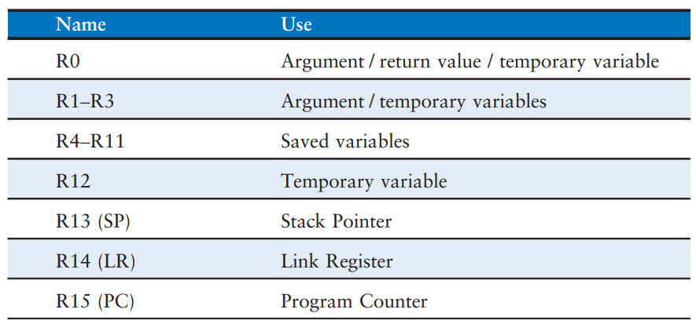
Register Sets
16 ARM Registers. R0 - R12 for storing variables.

Slide 13
ARM Instructions

Slide 14
Syntax for ARM Assembly
<instruction> <destination>, <source1>, <source2>

Slide 15
Constants in ARM
They are called immediate(s) or immediate operands.
They are preceded by a symbol #, e.g. #10.

Slide 16
Memory and Addresses
In ARM, instructions operate exclusively on registers, so data stored in memory must be moved to a register.
ARM uses 32-bit memory addresses, and 32-bit data words.
ARM ha a byte-addressable memory. Each byte in a memory has a unique address.
32-bit word = Four 8-bit bytes. Hence, each word address is a multiple of 4.

Slide 17
ARM Architecture in Summary
16 registers called register set or register file.
Arm instructions can also constants. They are called immediates or immediate operands. They don’t require registers or memory access.
Instructions operate exclusively on registers
Data stored in the memory must be moved to register first before it can processed.

Slide 18
Memory Map
Byte Address
Byte Address
…
…
13 | 12 | 11 | 10
F | E | D | C
B | A | 9 | 8
7 | 6 | 5 | 4
3 | 2 | 1 | 0
0000 0010
0000 000C
0000 0008
0000 0004
0000 0000
MSB
LSB

Slide 19
Memory Map
Data
Word Number
…
…
CD | 19 | A6 | 5B
40 | F3 | 07 | 88
01 | EE | 28 | 42
F2 | F1 | AC | 07
AB | CD | EF | 78
Word 4
Word 3
Word 2
Word 1
Word 0
Width = 4 bytes

Slide 20
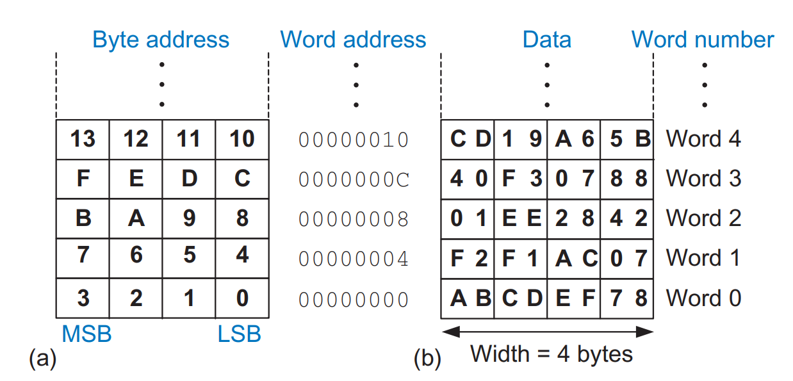
Memory in ARM Architecture
ARM architecture has 32-bit memory addresses, 32-bit data word.
Uses byte-addressable memory – each byte in the memory has a unique address
32 bit address = 8 bytes, each word address is a multiple of 4.
MSB on the left side, LSB on the right side
Low memory address at bottom, moving up towards high memory address.

Slide 21
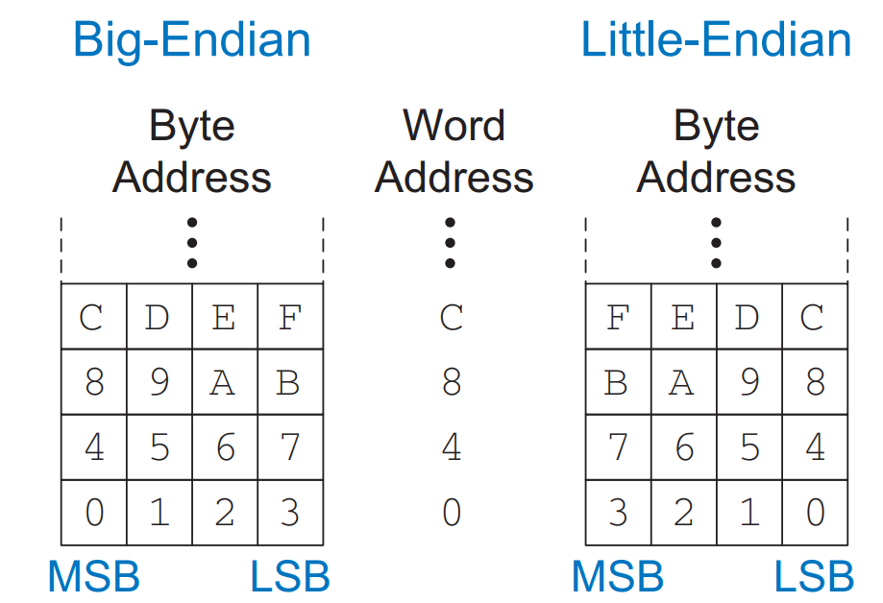
Little Endian and Big Endian
Two ways byte-addressable memories are organized: Little-Endian, Big-Endian.
Example:
Suppose integer is stored as 4 bytes.
If we have an integer variable x, whose value in hex is 0x01234567.
In Big Endian it is stored as
 | 0x100 | 0x101 | 0x102 | 0x103
 | 01 | 23 | 45 | 67
 | 0x100 | 0x101 | 0x102 | 0x103
 | 67 | 45 | 23 | 01
In Little Endian it is stored as

Slide 22
ARM Instruction Sets are Reduced Instruction Set Computer (RISC) Architecture
Number of common instruction sets is kept small.
Less hardware required to decode the instruction.
E.g. 64 simple instructions only require 6 bits (log₂64 = 6)

Slide 23
Register Operations

Slide 24
ARMv7
ARMv7 has 16 general-purpose registers (R0-R15). Some of these have special purposes:
R0-R12: General-purpose registers for data manipulation.
R13 (SP): Stack Pointer (points to the top of the stack).
R14 (LR): Link Register (stores the return address for functions).
R15 (PC): Program Counter (points to the next instruction to execute).

Slide 25
Examples of Instructions
ADD
HLL (High-level Language) Code:
a = b + c
ARM Assembly Code:
ADD a, b, c
SUBTRACT
HLL (High-level Language) Code:
a = b - c
ARM Assembly Code:
SUB a, b, c @ a = b - c
Start of the comment
Comment

Slide 26
Note
There are a few differences between book and how we will execute Assembly program in the CPUlator.
In the book,
OPCODE may be different.
Comments start with ;
In CPUlator, comments start with @

Slide 27
Register Specific Instructions
MOV: Move data between registers or a constant into a register.
LDR: Load data from memory into a register.
STR: Store data from a register into memory.

Slide 28
Initialize using Immediates
i = 0;
x = 4080;
@ R4 = i, R5 = x
MOV R4, #0 @ i = 0
MOV R5, #0xFF0 @ x = 4080
The move instruction (MOV) is a useful way to initialize register values.

Slide 29
Example 1
.global _start
_start:
MOV R0, #10
done:
b done @ after function return, infinitely loop here
Entry point of the program

Slide 30
Example 2
MOV R1, R0 @copy the value from R0 to R1

Slide 31
LDR Syntax
LDR <destination register>, <memory address>
Copies the data from memory into register

Slide 32
Reading Memory
a = mem[2];
@ R7 = a
MOV R5, #0 @ base address = 0
LDR R7, [R5, #8] @ R7 <= data at memory address (R5+8)
The LDR instruction specifies the memory address using a base register (R5) and an offset, which is 8 in this case. Each data word is 4 bytes, so word number 1 is at address 4, word number 2 is at address 8

Slide 33
Example 3: Load Operation
LDR R0, [R1] @load the value at memory address stored in R1 into R0

Slide 34
Example 4: Load with an Offset
LDR R0, [R1, #4] @load the value at memory address (R1+4) into 0

Slide 35
Example 5: Load from a Label or address
@ You can load data from a specific memory location defined by a label
.global _start
_start:
LDR R0, =mydata @ load the address of mydata into R0
LDR R1, [R0] @load the value at the address in R0 into R1
done:
b done @ after function return, infinitely loop here
.data
mydata: .word 0x12345678 @Define a 32-bit word in memory

Slide 36
STR
@ Store Data to Memory
STR < source>, <memory address>

Slide 37
Writing to Memory
mem[5] = 42;
MOV R1, #0 @ base address = 0
MOV R9, #42
@ value stored at memory address (R1+20) = 42
STR R9, [R1, #0x14]
ARM uses the store register instruction, STR, to write a data word from a register into memory.

Slide 38
Example 6: Store a value to a memory address
STR R0, [R1] @ store the value in R0 into the memory address stored in R1

Slide 39
Example 7: Store with an offset
STR R0, [R1, #8] @ Store the value in R0 into the memory address (R1+8)

Slide 40
Example 8: Store data to a label (address)
LDR R2, =mydata @load the address of `mydata` nto R2
STR R0, [R2] @store the value in R0 into the memory address stored in R2

Slide 41
Data Processing Instructions

Slide 42
Components of Instructions
a = b + 3
Accessing from registers is fast, but stores only small amount of data.
Accessing from memory is slow, can store a large amount of data.
Operand
Constant Operand
Stored in the instructions/part of the instruction
Stored in Register or Memory

Slide 43
Using Registers
a = b + c;
@ R0 = a, R1 = b, R2 = c
ADD R0, R1, R2 @ a = b + c

Slide 44
Temporary Registers
a = b + c − d;
@ R0 = a, R1 = b, R2 = c, R3 = d; R4 = t
ADD R4, R1, R2 @ t = b + c
SUB R0, R4, R3 @ a = t − d

Slide 45
Immediate Operands (i.e. use of constants in instructions)
a = a + 4;
b = a − 12;
@ R7 = a, R8 = b
ADD R7, R7, #4 @ a = a + 4
SUB R8, R7, #0xC @ b = a − 12
Constants are written in Hex.

Slide 46
Logical Instructions
AND, ORR (OR), EOR (XOR), and BIC (bit clear).
These each operate bitwise on two sources and write the result to a destination register.
The first source is always a register and the second source is either an immediate or another register.
Another logical operation, MVN (MoVe and Not), performs a bitwise NOT on the second source (an immediate or register) and writes the result to the destination register.
The bit clear (BIC) instruction is useful for masking bits (i.e., forcing unwanted bits to 0).
The ORR instruction is useful for combining bitfields from two registers.

Slide 47
Bitwise Logical Operations
r0 = r1 & r2;
r0 = r1 | r2;
r0 = r1 ^ r2
r0 = r1 & ~r2
AND r0, r1, r2
ORR r0, r1, r2
EOR r0, r1, r2
BIC r0, r1, r2 ;
BIC stands for ‘bit clear’ – each ‘1’ in r2 clears the corresponding bit in r1.

Slide 48
Shift Instructions
Shifts the values in a register left or right, dropping bits off the end.
A variant of the shift instruction, called rotate instruction doesn’t drop bits off the end but rotate.

Slide 49
Left shift
This can be a register instead of an immediate as well
b = a << 2;
LSL R0, R5, #2 @logic shift left
Logical Left shift.
R5 is shift by 2 places to the left and the value is stored in the register R0.

Slide 50
Right shift
b = a >> 2;
LSR R0, R5, #2 @logic shift left
Logical Right shift.
R5 is shift by 2 places to the right and the value is stored in the register R0.

Slide 51
Rotate
// Make sure the shift value is within [0, 31]
shift = shift % 32;
b = (a >> shift) | (a << (32 - shift));
ROR R3, R5, #21@ rotate right
There is no equivalent ROL, but left operation can be performed with right rotation by a complementary amount.
C doesn’t have equivalent rotate operator, but we can write a program to implement an equivalent operation. Alternative we can do in C++ using operator overloading.

Slide 52
Arithmetic Shift Right vs Logical Shift Right
ARM Instruction sets also have ASR (Arithmetic Shift Right) which is slightly different from LSR.
In LSR, when bits are shifted, the new bits to the left is 0.
In ASR, when bits are shifted, the new bits to the left is filled with the same bit as original MSB.
Example. Let R5 = 1111000
LSR R2, R5 #2 will save 0011110 in R2
ASR R2, R5 #2 will save 1111110

Slide 53
Multiply Instruction
Multiplying two 32 bit numbers may produce a 64 bit number.
We have two kind of multiply instructions in ARM
MUL – produces 32 bit results
UMULL – unsigned multiply long, produces 64 bit from unsigned numbers – stored in two registers
SMULL – signed multiply long, produces 64 bit from signed numbers – stored in two registers

Slide 54
Multiply Instruction
a = b*c;
MUL R1, R2, R3
multiplies R2 and R3 and places the least significant 32 bit of the result in R1 and discard the most significant 32 bits

Slide 55
Multiply Instruction
a = b*c;
SMULL R1, R0, R2, R3
UMULL R1,R0, R2, R3
multiplies R2 and R3 and places the least significant 32 bit of the result in R1 and the most significant 32 bits is placed in R0.

Slide 56
Multiply-accumulate Variant
d = (a*c) + d
MLA R10, R1, R2, R3
to be multiplied
to add
The MLA instruction multiplies the values from R1 and R2, adds the value from R3, and places the least significant 32 bits of the result in R10.

Slide 57
SMLAL (Signed Multiply Accumulate Long)
SMLAL R1, R2, R3, R4
Most significant 32 bits
Least significant 32 bits
It basically does operation as
[R2 R1] = [R2 R1] + (R3*R4)
We can have similar operation with UMLAL

Slide 58
Conditional Flags
Executing instruction, conditional depending on the value of flags.
Also known as status flags.
Negative (N): Instruction result is negative, i.e. bit 31 of the result is 1.
Zero (Z): Instruction result is zero.
Carry (C): Instruction results in a carry out
Overflow (V): Instruction causes an overflow
The most common way to set the status bits is with the compare (CMP) instruction, which subtracts the second source operand from the first and sets the condition flags based on the result. For example, if the numbers are equal, the result will be zero and the Z flag is set.

Slide 59
Current Program Status Register (CPSR)
The ARM core uses the CPSR to monitor and control internal operations. The CPSR is a dedicated 32-bit register and resides in the register file.
The CPSR is divided into four fields, each 8 bits wide: flags, status, extension, and control.
Flags | Status | Extension | Control
31, 30, 29, 28 …
… 4, 3, 2, 1, 0

Slide 60
Current Program Status Register (CPSR)
Flags | Status | Extension | Control
31, 30, 29, 28 …
… 4, 3, 2, 1, 0
Reserved for the future use.
N: Instruction result is negative, i.e. bit 31 of the result is 1.
Z: Instruction result is zero. bit 30
C: Instruction results in a carry out. bit 29
V: Instruction causes an overflow. bit 28
Q: Cumulative saturation/Sticky Flag. bit 27
IT[1:0]: Reserved. bits 26, 25
J: Reserved. bit 24. Some newer version indicates whether the core is in Jazelle state (we will discuss this later).
N Z C V Q IT[1:0] J
Together, they are called Application Program Status Register (APSR)

Slide 61
Current Program Status Register (CPSR)
Flags | Status | Extension | Control
31, 30, 29, 28 …
… 4, 3, 2, 1, 0
Includes the processor mode, status, and interrupt mask bits
M = Processor Mode
T = indicates whether the core is in Thumb state.
F = disables Fast interrupt request (FIQ)
I = disables standard interrupt request (IRQ)
A = disables asynchronous aborts.
A I F T M[4:0]
We will discuss this later

Slide 62
Example using Condition Flags
@ CMP (Compare) Subtracts the value of Operand2
@ Initialize R0, R1, and R2
MOV R0, #10
MOV R1, #10
MOV R2, #20
@ Non-destructive subtract (R0, R1, R2 are not modified), update flags registers
CMP R0, #10 @ N=0, Z=1, C=1, V=0
CMP R0, R1 @ N=0, Z=1, C=1, V=0
CMP R0, R2 @ N=1, Z=0, C=0, V=0

Slide 63
Conditional Instructions
Using the status flags in the APSR, you can write assembly instructions that will conditionally execute. Conditional instructions allow us to implement high level language constructs like if/else and for loops.
We have Condition Mnemonics to implement conditional instructions in ARM ISA.

Slide 64
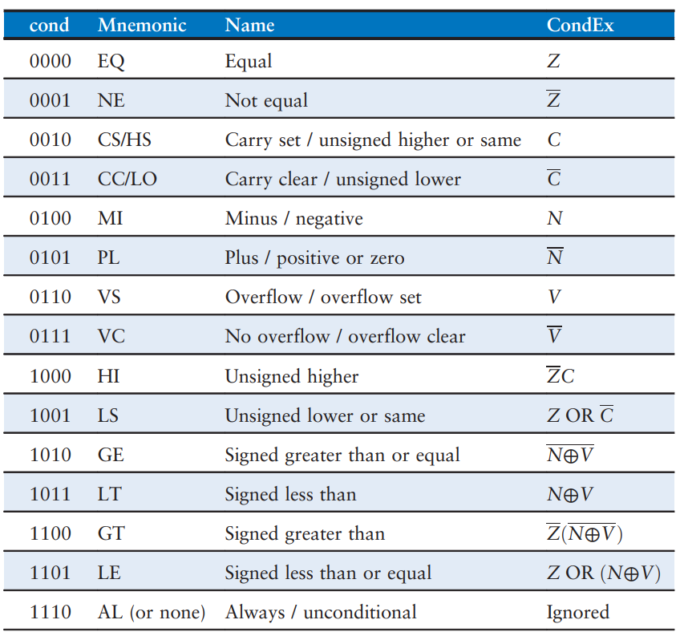

Slide 65
Data Processing Instruction with Condition Flags
Other data-processing instructions will set the condition flags when the instruction mnemonic is followed by “S.” For example, SUBS R2, R3, R7 will subtract R7 from R3, put the result in R2, and set the condition flags.
All data-processing instructions will affect the N and Z flags based on whether the result is zero or has the most significant bit set. ADDS and SUBS also influence V and C, and shifts influence C.

Slide 66
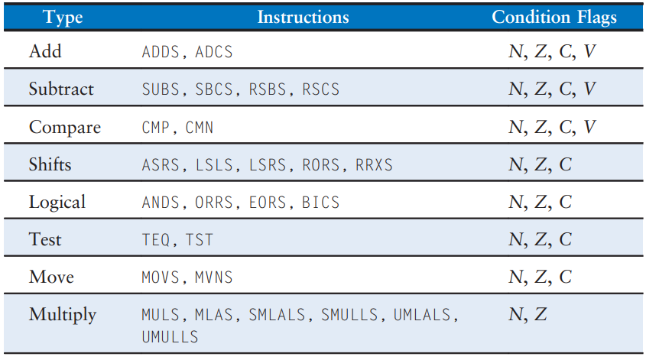

Slide 67
Example: Condition Execution
@R2 = 0x80000000
@R3 = 0x00000001
CMP R2, R3
ADDEQ R4, R5, #78
ANDHS R7, R8, R9
ORRMI R10, R11, R12
EORLT R12, R7, R10
Executes unconditionally, 0x80000000 – 0x00000001 = 0x80000000 + 0xFFFFFFFF = 0x7FFFFFFF, with C= 1, V = 1
ADDEQ and ORRMI do not execute because the result of R2 – R3 is not zero (i.e., R2 ≠ R3) or negative. ADDEQ onnly adds if Z =0. ORRRMI only executes of the result is negative.
Executes because R2 ≥ R3 (unsigned).
Executes because R2 < R3 (signed)

Slide 68
What does this program do, write a C-equivalent? (In-class Exercise)
MOV R0, #10
CMP R0, #5
MOVGT R0, #7
MOVLE R0, #0

Slide 69
What does this program do? (In-class Exercise Solution)
i = 10;
if(i>5)
i = 7;
else
i = 0;
@ Initialize R0
MOV R0, #10
@ If Else
CMP R0, #5
MOVGT R0, #7
MOVLE R0, #0

Slide 70
Branching
Most computer architectures including ARM architecture use branch instructions to skip over sections of code or repeat code.
A program usually executes in sequence, with the program counter (PC) incrementing by 4 after each instruction to point to the next instruction. (Recall that instructions are 4 bytes long and ARM is a byte-addressed architecture.) Branch instructions change the program counter.

Slide 71
Branch Instructions
B: Simple Branching
BL: Branch Link (used for function calls)
Branches can be unconditional or conditional. They are also called jumps in some other architectures.

Slide 72
Branch Instruction Example 1
ADD R1, R2, #17 @ R1 = R2 + 17
B TARGET @ branch to TARGET
ORR R1, R1, R3 @ not executed
AND R3, R1, #0xFF @ not executed
TARGET
SUB R1, R1, #78 @ R1 = R1 − 78
Kind of like GOTO in C
Branch label: cannot be a reserved keyword/mnemonics
Always executed, either after skipping ORR and AND, or after executing them

Slide 73
Branch Instruction Example 2
MOV R0, #4 @ R0 = 4
ADD R1, R0, R0 @ R1 = R0 + R0 = 8
CMP R0, R1 @ set flags based on R0−R1 = −4. NZCV = 1000
BEQ THERE @ branch not taken (Z != 1), branch dependent on equality
ORR R1, R1, #1 @ R1 = R1 OR 1 = 9
THERE
ADD R1, R1, #78 @ R1 = R1 + 78 = 87
When code reaches the BEQ instruction, the Z = 0, i.e., R0 ≠ R1. So the branching doesn’t happen. Hence ORR is executed. Execution never go to THERE

Slide 74
Conditional Statements
If/else,
switch/case

Slide 75
Example: if
if (apples == oranges)
f = i + 1;
f = f − i;
@ R0 = apples, R1 = oranges, R2 = f, R3 = i
CMP R0, R1 @ apples == oranges ?
BNE L1 @ if not equal, skip if block
ADD R2, R3, #1 @ if block: f = i + 1
L1
SUB R2, R2, R3 @ f = f − i

Slide 76
Example: if/else
if (apples == oranges)
f = i + 1;
else
f = f − i;
@ R0 = apples, R1 = oranges, R2 = f, R3 = i
CMP R0, R1 @ apples == oranges?
BNE L1 @ if not equal, skip if block
ADD R2, R3, #1 @ if block: f = i + 1
B L2 @ skip else block
L1
SUB R2, R2, R3 @ else block: f = f − i
L2

Slide 77
Example: switch/case
switch (button) {
case 1: amt = 20; break;
case 2: amt = 50; break;
case 3: amt = 100; break;
default: amt = 0;
}
// equivalent function using
// if/else statements
if (button == 1)amt = 20;
else if (button == 2)amt = 50;
else if (button == 3) amt = 100;
else amt = 0;
@ R0 = button, R1 = amt
CMP R0, #1 @ is button 1 ?
MOVEQ R1, #20 @ amt = 20 if button is 1
BEQ DONE @ break
CMP R0, #2 @ is button 2 ?
MOVEQ R1, #50 @ amt = 50 if button is 2
BEQ DONE @ break
CMP R0, #3 @ is button 3?
MOVEQ R1, #100 @ amt = 100 if button is 3
BEQ DONE @ break
MOV R1, #0 @ default amt = 0
DONE

Slide 78
Loops
Repeatedly executing a certain task.
while loop
for loop

Slide 79
Loop Example: while loop
int pow = 1;
int x = 0;
while (pow != 128) {
pow = pow * 2;
x = x + 1;
}
@ R0 = pow, R1 = x
MOV R0, #1 @ pow = 1
MOV R1, #0 @ x = 0
WHILE
CMP R0, #128 @ pow != 128 ?
BEQ DONE @ if pow == 128, exit loop
LSL R0, R0, #1 @ pow = pow * 2
ADD R1, R1, #1 @ x = x + 1
B WHILE @ repeat loop
DONE

Slide 80
Loop Example: for loop
int i;
int sum = 0;
for (i = 0; i < 10; i = i + 1) {
sum = sum + i;
}
@ R0 = i, R1 = sum
MOV R1, #0 @ sum = 0
MOV R0, #0 @ i = 0 loop initialization
FOR
CMP R0, #10 @ i < 10 ? check condition
BGE DONE @ if (i >= 10) exit loop
ADD R1, R1, R0 @ sum = sum + i loop body
ADD R0, R0, #1 @ i = i + 1 loop operation
B FOR @ repeat loop
DONE
Notes:
Reference: https://ece353.engr.wisc.edu/arm-assembly/conditional-instructions/

Slide 81

Video of the day
How Amateurs created the world´s most popular Processor (History of ARM Part 1)
https://www.youtube.com/watch?v=nIwdhPOVOUk

